Slide 1
ENERGY CONSUMPTION FORECASTING USING AI – MACHINE LEARNING ALGORITHM.
Done By:
HARIHARA MOORTHI.A ,
Reg . No.:912321104302,
Branch: III – year , CSE department,
Email ID: hrihri006@gmail.com ,
Naan mudhalvan ID : aut22cs302,
College Name : SACS MAVMM Engineering College,
Madurai.

Slide 2
OUTLINE
Problem Statement
Proposed System / Solution
System Development Approach
Algorithm & Deployment
Result
Conclusion
Reference

Slide 3
PROBLEM STATEMENT:
The problem statement for energy consumption optimization using AI and ML involves developing algorithms and models to analyze and predict energy.usage patterns, identify inefficiencies, and optimize resource allocation in various sectors such as residential, commercial, and industrial.

Slide 4
PROPOSED SYSTEM / SOLUTION:
Data Collection:
Gather historical energy consumption data from various sources such as smart meters, IoT devices, sensors, weather data, and building management systems.
Data Preprocessing:
Clean, preprocess, and normalize the collected data to ensure consistency and quality.
Feature Engineering:
Extract relevant features from the preprocessed data that can provide insights into energy usage patterns.

Slide 5
PROPOSED SYSTEM / SOLUTION(CONT…)
Model Development:
Utilize machine learning algorithms such as regression, time eries analysis, clustering, and neural networks to develop predictive models.
Training and Validation:
Train the machine learning models using historical data and validate their performance using cross-validation techniques to ensure accuracy and reliability.
Real-time Monitoring:
Implement a real-time monitoring system that continuously collects data from sensors and devices, applies the trained models to make predictions.

Slide 6
PROPOSED SYSTEM / SOLUTION(CONT…)
Decision Support System:
Integrate the AI and ML models with a decision support system that provides actionable insights and recommendations for optimizing energy consumption, scheduling equipment operations, and adjusting resource allocation based on predicted demand and cost factors.
Feedback Loop:
Incorporate a feedback loop mechanism to update the models over time with new data and insights, enabling continuous improvement and adaptation to changing conditions and requirements.

Slide 7
SYSTEM DEVELOPMENT APPROACH(CONT...)
Networking Equipment:
Reliable networking infrastructure is essential for connecting sensors, devices, servers, and other components of the energy optimization system.
Edge Computing Devices:
In some cases, edge computing devices may be deployed at the site of energy consumption to perform real-time data processing and analysis locally, reducing latency and bandwidth requirements.

Slide 8
SYSTEM DEVELOPMENT APPROACH(CONT...)
Security Infrastructure:
Implement robust security measures to protect sensitive energy consumption data from unauthorized access, tampering, or cyber-attacks.
Backup and Redundancy:
Implement backup and redundancy mechanisms to ensure data integrity and system availability in case of hardware failures or disasters.

Slide 9
SYSTEM DEVELOPMENT APPROACH:
a. HARDWARE REQUIREMENT:
Servers or Cloud Infrastructure:
Powerful servers or cloud computing resources are needed to train machine learning models, perform data preprocessing, and run predictive analytics algorithms.
Data Storage:
High-capacity storage systems are required to store historical energy consumption data, sensor readings, weather data, and other relevant information.
Sensors and IoT Devices:
Deploy sensors and IoT devices to collect real-time data on energy usage, building occupancy, equipment status, and environmental conditions.

Slide 10
SYSTEM DEVELOPMENT APPROACH(CONTD…)
b. SOFTWARE REQUIREMENT:
Machine Learning Libraries:
Utilize machine learning frameworks and libraries such as TensorFlow, PyTorch, scikit-learn, or Keras for developing and training predictive models.
Data Analysis Tools :
Use data analysis and visualization tools such as Pandas, NumPy, and Matplotlib to explore and analyze energy consumption data, extract meaningful insights, and visualize trends and patterns.
Database Management Systems:
Deploy database management systems (DBMS) such as MySQL, PostgreSQL, or MongoDB for storing and managing large volumes of energy consumption data.

Slide 11
SYSTEM DEVELOPMENT APPROACH(CONTD…)
b. SOFTWARE REQUIREMENT(CONTD...):
Real-time Data Processing Platforms:
Real-time data processing platforms such as Apache Flink for ingesting, processing, and analyzing streaming data from sensors and IoT devices.
Programming Languages:
Use programming languages such as Python for energy consumption optimization.
IoT Platforms:
Integrate with IoT platforms such as Google Cloud IoT, or Microsoft Azure IoT for managing and controlling IoT devices, collecting sensor data, and implementing edge computing solutions.

Slide 12
ALGORITHM & DEPLOYMENT:
a.ALGORITHM :
Linear Regression:
For predicting energy consumption based on historical data and relevant features such as time of day, weather conditions, and building occupancy.
Time Series Analysis:
Techniques like AutoRegressive Integrated Moving Average or Long Short-Term Memory neural networks can be used for forecasting energy demand over time, considering seasonality and trend patterns.

Slide 13
ALGORITHM & DEPLOYMENT
a. ALGORITHM(CONTD...):
Clustering:
Algorithms like K-means clustering can help identify groups of similar energy consumption patterns, which can be used for segmentation and targeted optimization strategies.
Anomaly Detection:
Methods such as Isolation Forest or One-Class SVM (Support Vector Machine) can be employed to detect unusual or abnormal energy consumption patterns that may indicate equipment malfunction or inefficiencies.
Reinforcement Learning:
RL algorithms can be used to optimize energy usage in dynamic environments by learning optimal control policies through trial-and-error interactions with the system.

Slide 14
ALGORITHM & DEPLOYMENT (CONTD...)
DEPLOYMENT :
Model Serialization:
Serialize the trained ML models into a format suitable for deployment, such as a pickle file in Python or a PMML (Predictive Model Markup Language) file for interoperability with other systems.
Integration:
Integrate the serialized models into the deployment environment, whether it’s a cloud-based platform, edge computing device, or on-premises server.
API Development:
Develop APIs (Application Programming Interfaces) or microservices to expose the functionality of the ML models, allowing other systems or applications to interact with them for making predictions .

Slide 15
ALGORITHM & DEPLOYMENT(CONT…) :
DEPLOYMENT (CONTD...) :
Scalability and Performance Optimization:
Ensure that the deployment architecture is scalable and can handle the expected workload efficiently.
Monitoring and Maintenance:
Implement monitoring tools and logging mechanisms to track the performance of the deployed system, detect any anomalies or errors, and perform regular maintenance tasks.

Slide 16
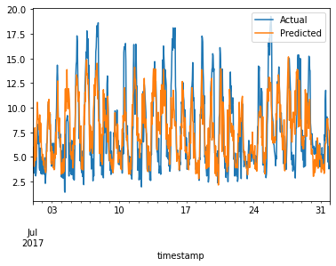
RESULT :
Fig.:- Predictions for measurements and verification

Slide 17
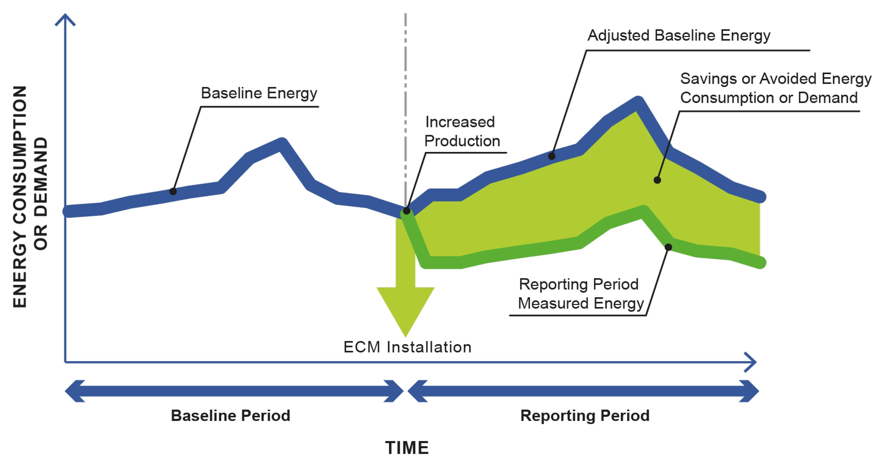
RESULT :
Fig.:- Predictions for measurements and verification

Slide 18
CONCLUSION :
In conclusion, the deployment of an energy consumption optimization system leveraging AI and ML technologies has proven to be a significant step towards achieving greater efficiency, cost savings, and sustainability in various sectors.

Slide 19
REFERENCE :
https://www.tensorflow.org/
https://keras.io/
https://numpy.org/
https://matplotlib.org/
https://www.sky-learn.com/
https://www.kaggle.com/datasets/hojjatk/mnist-dataset

Slide 20
THANK YOU

